Slide 1
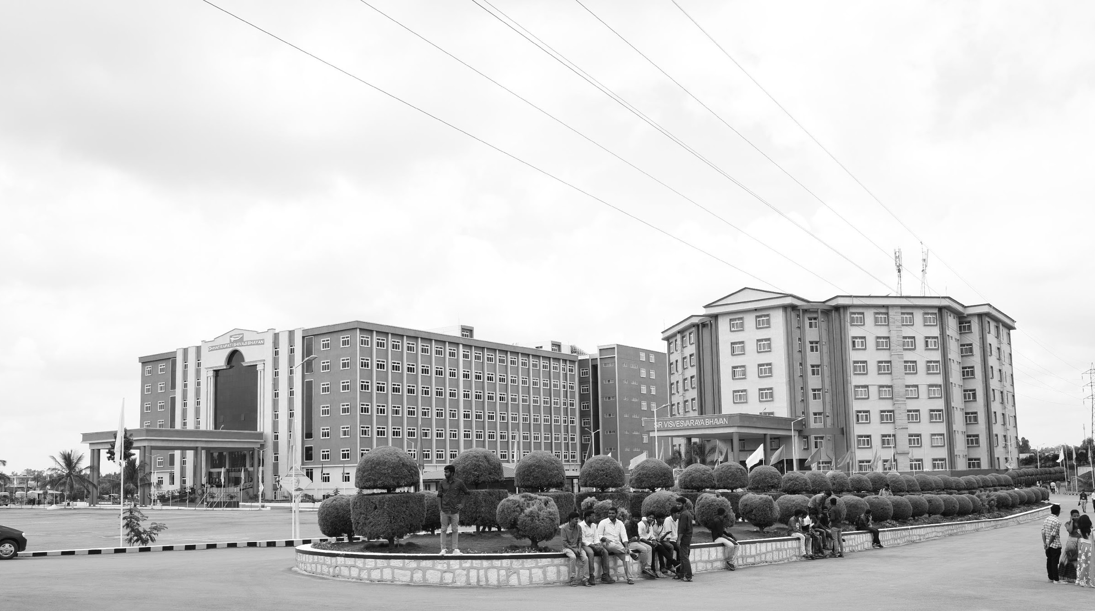

Review-I
Title of the Project : Quantum Inspired Antenna Array Design
AY 2025-26
Capstone Project – Introduction (PROJ2999)
GITAM (Deemed-to-be) University
Department of Electrical Electronics and Communication Engineering
Project Team:
Project Mentor:
Dr. Avishek Chakraborty
Project In-charge:
Dr. Jaya Prakash Sahoo
MEESALA EESHA(BU22EECE0100424)
MOKSHAGNA REDDY(BU22EECE0100089)
ALURU RAKSHITHA(BU22EECE0100222)
www.gitam.edu

Slide 2
Objective and Goals
Objective
The main objective of this project is to design and analyze antenna arrays for modern communication systems by leveraging the principles of quantum computing. The project aims to develop more efficient, intelligent, and faster systems for tasks like beamforming and interference suppression by integrating quantum-inspired algorithms.
Goals
Main Goals: Implement QGA and QFT to optimize antenna array radiation patterns, benchmark them against classical methods, and apply them to 5G/6G, radar, and satellite systems.
Additional Goals: Explore other quantum-inspired algorithms like RQGA and Quantum Annealing, develop a project management plan with a Gantt Chart, and test the methods on different array geometries and a hybrid quantum-classical framework.

Slide 3
Project Plan:Quantum-Inspired Antenna Array Design
This project plan provides a simple, clear overview of the key phases and milestones for your capstone project.
Phase 1: Foundation (Completed)
Goal: To set up the project's basic theory and structure.
Milestones:
Project proposal approved.
Research on existing work is done and Initial design is complete.
Phase 2: QGA Testing (Upcoming)
Goal: To build and test the Quantum Genetic Algorithm (QGA).
Milestones:
QGA code is built and ready.
Results for 16- and 32-element arrays are collected and report comparing QGA and classical GA is written.
Review-II Presentation is complete.
Phase 3: QFT Integration (Upcoming)
Goal: To add the Quantum Fourier Transform (QFT) for faster analysis.
Milestones:
QFT code is integrated with the main project.
QFT's speed is compared with classical methods.
The final results are checked and confirmed.
Review-III Presentation is complete.
Phase 4: Final Submission (Upcoming)
Goal: To finish all project work and prepare for the final defense.
Milestones:
The final project report is submitted.
The final presentation is ready.
Project Defense is complete.

Slide 4
Concepts and Theory
1. Quantum-Inspired Optimization
Traditional antenna array optimization problems are often
2.NP-hard and computationally demanding, especially for large arrays. Classical metaheuristic algorithms like Genetic Algorithms (GA) can get stuck in a local optimum and have slower convergence.
3.Qantum-inspired algorithms offer a solution by incorporating principles from quantum mechanics into classical computation.
4.Qubit Representation: Unlike a classical bit (0 or 1), a qubit can exist in a superposition of both states simultaneously. In this approach, a single qubit can represent a combination of all possible solutions, allowing the algorithm to explore a wider search space and maintain population diversity.
5.Quantum Gates: The algorithm uses quantum gates, such as rotation gates, to evolve the population. These gates manipulate the phase and amplitude of the qubits, guiding the search toward the optimal solution.
6.Measurement: A measurement operation is performed to collapse the superposition, yielding a single classical solution that can be evaluated.

Slide 5
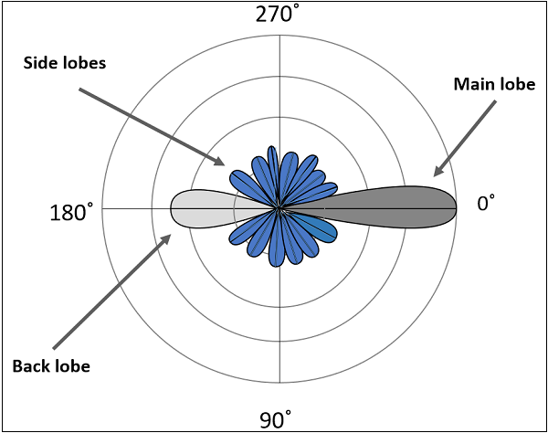
Literature Survey
Key Publications from our Review
Radiation Pattern Synthesis and Optimization
Improved Quantum Genetic Algorithm (QGA): A paper by Ming Liu et al. presents an improved QGA that uses quantum principles to optimize the amplitudes and phases of antenna arrays. This method achieved deeper nulls (around −85 dB compared to −70 dB with classical GA) and faster convergence for a 32-element linear array.
Real-Coded Quantum Genetic Algorithm (RQGA): Another study by Ming Liu et al. introduces an RQGA that uses a real-number encoding instead of binary. This approach resulted in higher precision, better stability, and faster convergence for radiation pattern synthesis in smart antennas.
Quantum Annealing: A paper by Annalise Stockley and Keith Briggs reformulates the NP-hard antenna beamforming problem into a format solvable by a quantum annealer. This offers a potential for time and energy savings for large-scale optimization.

Slide 6

Literature Survey
Computational Speed and Analysis
Quantum Fourier Transform (QFT): Several papers by Luca Tosi and Paolo Rocca et al. explore the use of QFT to compute radiation patterns. Their research demonstrates a significant exponential speed-up, reducing computational complexity from O(NlogN) (for classical FFT) to O(log2N). They validated this approach on real quantum hardware like the IBM Q Experience, showing the feasibility of the concept.
Hardware Limitations: While QFT offers a theoretical speed-up, the papers note that current quantum hardware is limited by a small number of qubits and noise, which can affect accuracy. Most results are based on simulations rather than large-scale practical implementations.

Slide 7

Literature Survey
General Quantum-Inspired Methods
Review of Metaheuristics:
A comprehensive review by Shahin Hakemi et al. highlights how quantum-inspired algorithms improve population diversity, global search capabilities, and computational efficiency for solving complex optimization problems. They show that these methods offer significant improvements across various fields, even when run on classical computers.
Disadvantages: A common drawback across these methods is the higher computational cost compared to classical algorithms and a reliance on careful parameter tuning. Most implementations are still limited by the capabilities of current quantum simulators and hardware.

Slide 8
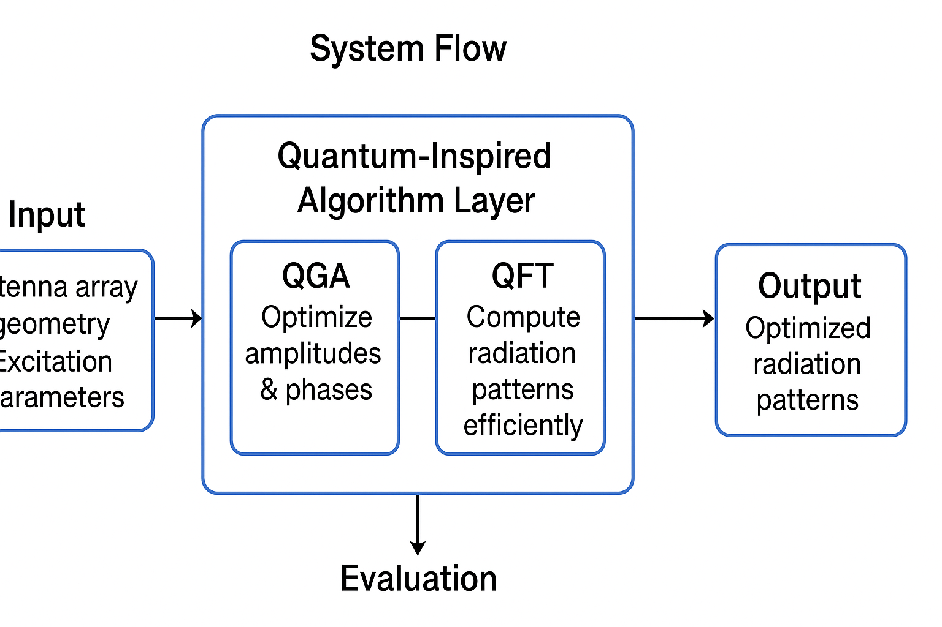
Architecture
Structural Diagram Theory
System Flow Diagram The system begins with the antenna array's geometry and excitation parameters as inputs. This information is processed by a Quantum-Inspired Algorithm Layer. This layer has two main components:
QGA: This component is responsible for optimizing the amplitudes and phases of the array elements to achieve the desired radiation pattern.
QFT: This component efficiently computes the radiation pattern based on the optimized parameters. The outputs are the optimized radiation patterns, which are then evaluated based on key performance metrics.

Slide 9
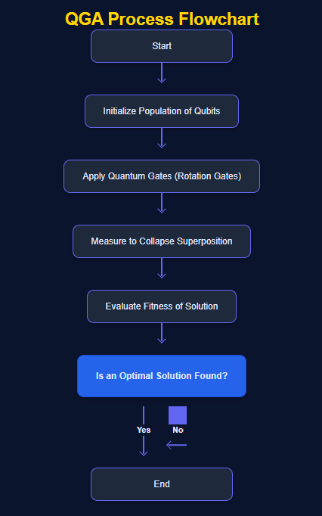
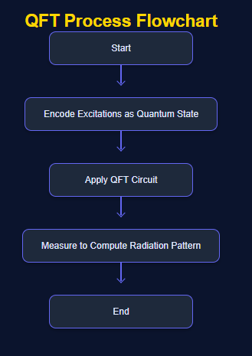
Architecture
Behaviour Diagram
QGA Process Flow: The process starts by initializing a population of qubits. Rotation gates are then applied to update the chromosome, or the candidate solution. The fitness of the solution is evaluated by analyzing the radiation pattern. The algorithm iterates these steps until an optimal solution is found.
QFT Process Flow: The excitations of the antenna array are encoded as a quantum state. A QFT circuit is applied to this state. The quantum state is then measured to compute the final radiation pattern.

Slide 10
Use Cases & Testing(Upcoming)
Use Cases
5G/6G: Our methods can be applied to massive MIMO systems to enable smarter and more efficient beamforming, increasing system capacity and coverage.
Adaptive Radar: Quantum-inspired algorithms can be used for adaptive nulling to suppress unwanted interference and improve target tracking in radar systems.
Satellite Communications: The methods can be applied to optimize satellite links, ensuring efficient communication with minimal interference.
Defense: The ability to perform adaptive beamforming and interference suppression makes these methods useful for secure communication systems, even under jamming attacks.
Test Cases
Algorithm Comparison: We will compare the performance of our QGA and QFT implementations against classical methods like GA and DFT.
Array Size Evaluation: The performance will be evaluated on both 16-element and 32-element arrays using simulation tools like MATLAB.
Metrics: We will measure key metrics, including null depth, sidelobe level (SLL), beamwidth, and convergence speed.

Slide 11
Implementation and Results – Iteration 1

Slide 12
Implementation and Results – Iteration 2

Slide 13
Implementation and Results – Iteration 3(Optional)

Slide 14
Conclusion & Future Work
Summary and Conclusion
Quantum-inspired methods have been shown to be a highly promising approach for solving complex antenna array optimization problems.
QGA provides superior performance, achieving deeper nulls and faster convergence than classical GAs.
QFT offers a significant computational advantage for radiation pattern analysis, reducing complexity and computation time.
The feasibility of these methods has been successfully validated through simulations on frameworks like IBM Qiskit, showing they can accurately match classical results while offering a path to future speed-ups.
Future Work
Scalability: We plan to extend our work to large-scale phased arrays and massive MIMO systems, which are key components of future 6G networks.
Hybrid Solutions: We will explore the development of hybrid quantum-classical solvers that can leverage both classical and quantum hardware to overcome the limitations of current quantum processors.
Hardware Implementation: As quantum hardware evolves, we will test and validate our algorithms on more scalable, real quantum processors to move beyond simulation.

Slide 15
THANK YOU
Have a Great Day !
🌟 “Quantum today, Smarter Antennas tomorrow!” 🌟

